Slide 1

Greater Yosemite Council
Kernels Training Meeting

Slide 2

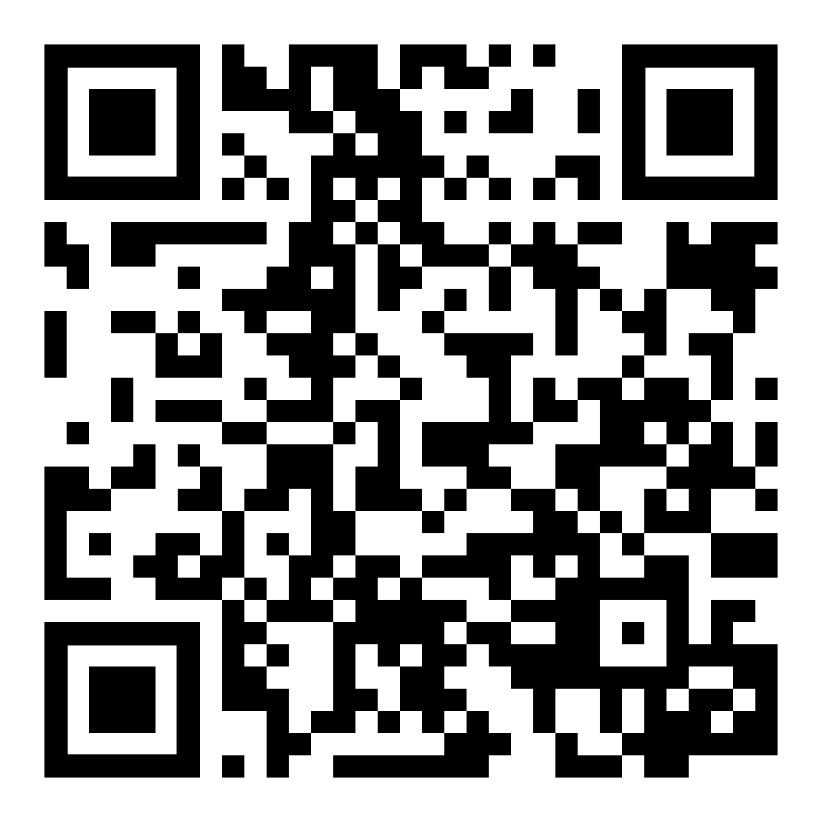
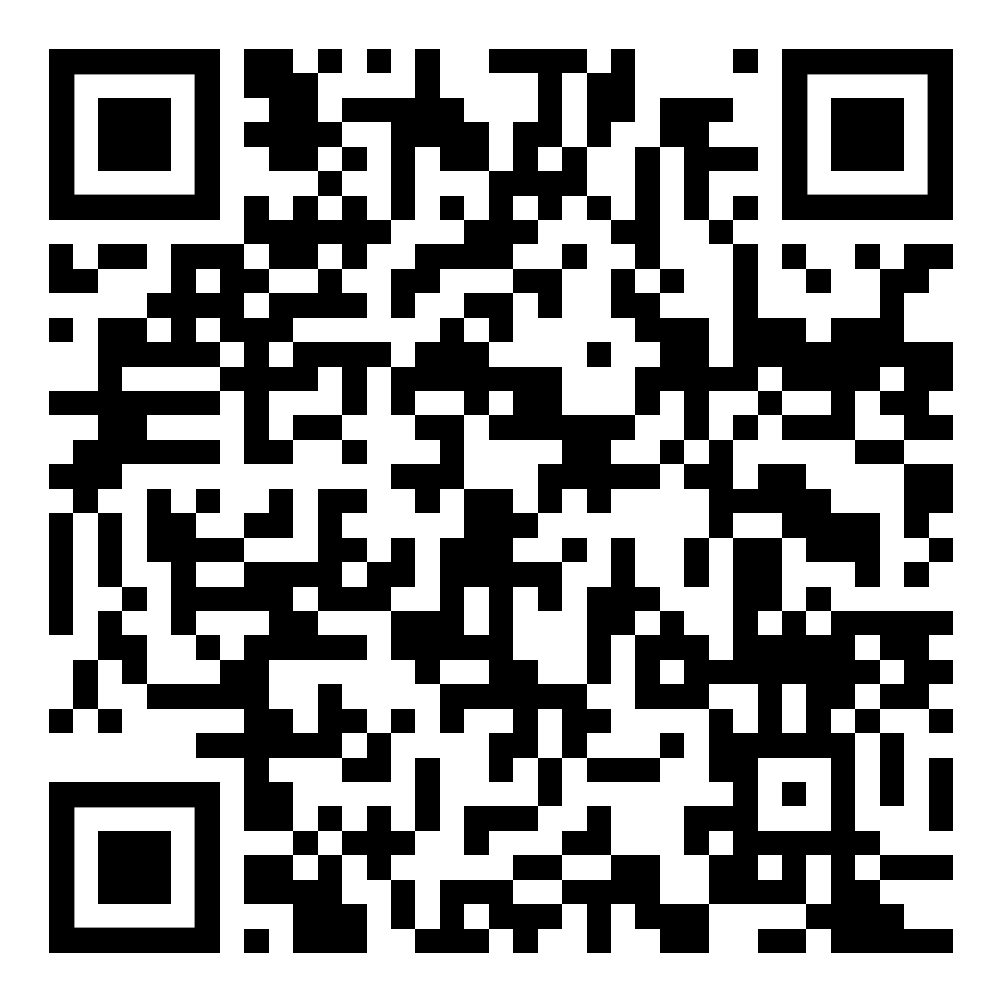
SIGN UP YOUR UNIT!
Sign Up to Get Emails from Trails End and the Council
Kernel’s Corner Website

Slide 3
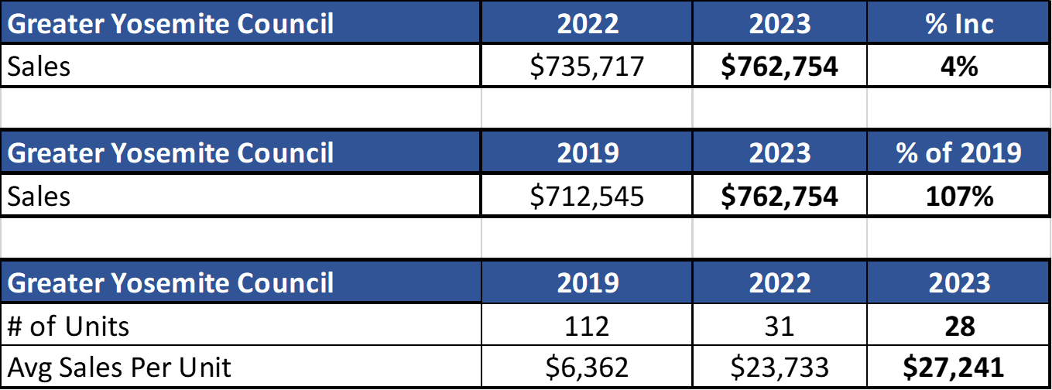

2023 SALES

Slide 4
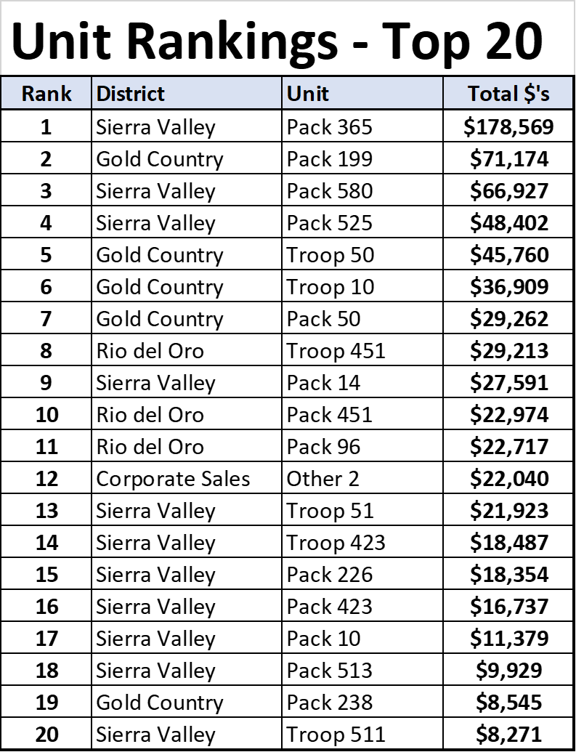
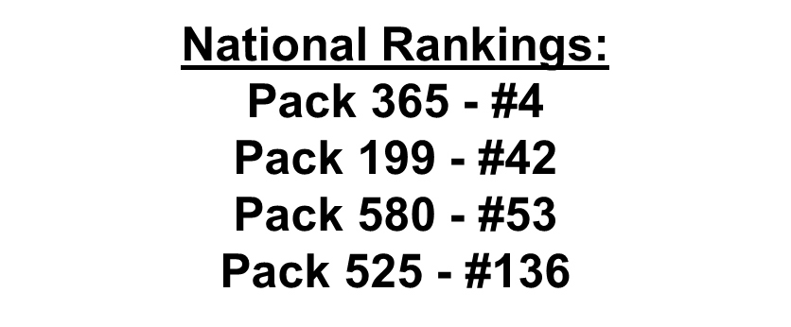

Top 20 Units
*Roughly 10,000 Units sold popcorn this Fall

Slide 5
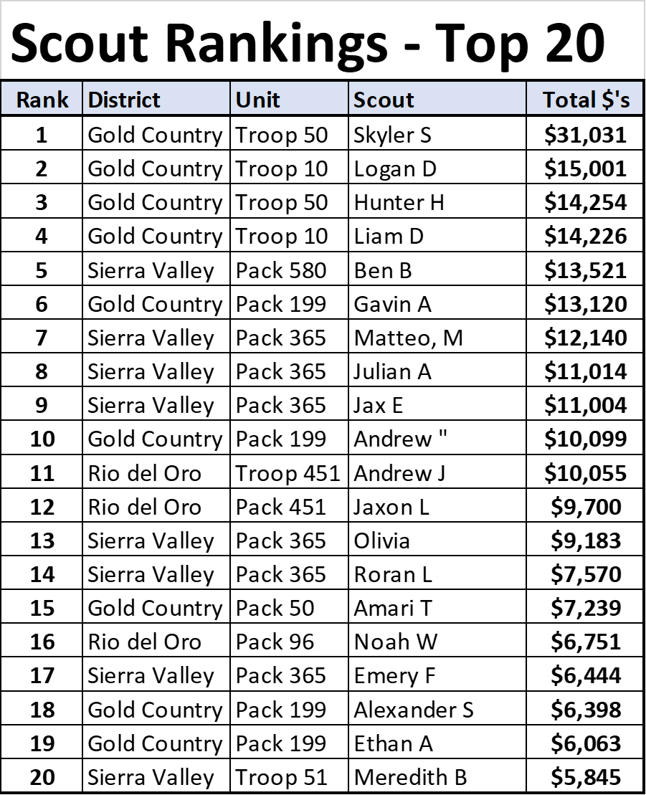
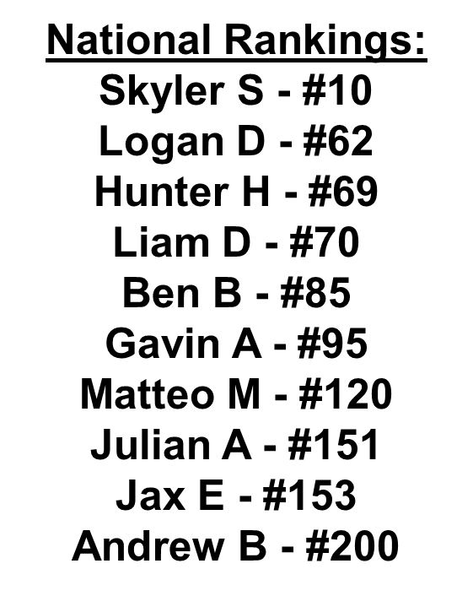

Top 20 Scouts

Slide 6
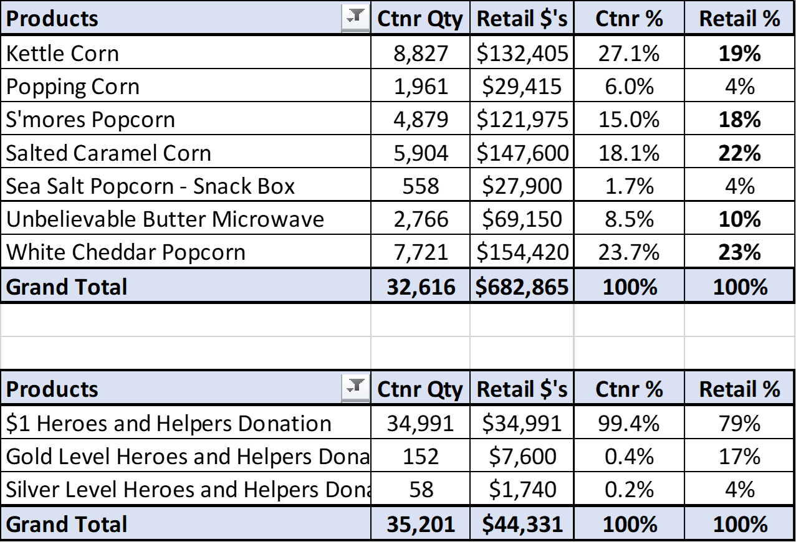
Product Mix

Slide 7

Powered by Popcorn
Scout Fundraising
Benefits for Scouts
Personal growth program that can be applied to advancement opportunities and service projects.
Earn Amazon eGift Cards
  Millions of prize choices
  Scouts choose the prizes they want
Scouts Learn
How to help others around them
Public speaking & math skills
Salesmanship & perseverance
How to earn their own way
The value of hard work
How to handle rejection

Slide 8

prepare
pre·​pare
prepared; preparing
transitive verb
to make ready beforehand for some purpose, use, or activity

Slide 9

Ideal Year of Scouting
Scout Fundraising
Plan Program
List activities & adventures
Hold a brainstorming session with families
Incorporate new adventures & activities.
Budget
Assign costs to activities and expenses.
Add in camp, registration fees, advancements & Unit dues.
Calendar
Provide a monthly calendar of activities so families are aware of the fun.
Set Goals
Calculate Unit goal: divide budget by expected popcorn commissions.
Divide Unit goal by # of Scouts to get Scout goals
Raise the Money
Conduct one fundraiser
    and .
Less time fundraising = more time Scouting!
Enjoy the Year!
Notes:
Include family planner (from IYOS scope sheet)

Slide 10
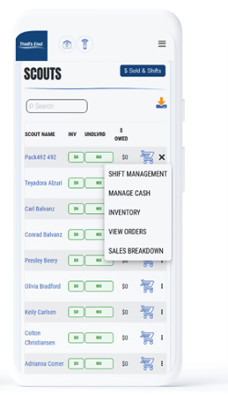
Leader Portal
Scout Fundraising
https://portal.trails-end.com/
Your one-stop-shop for sale management!
Order Popcorn
Invite their Scouts to register; manage Scout roster.
Easily set Unit and Scout goals.
View real time reporting of sales, inventory and cash management; all in one place.
Unit-to-Unit product transfers. No Council intervention needed.
Create, schedule, and manage storefront sites and shifts.

Slide 11
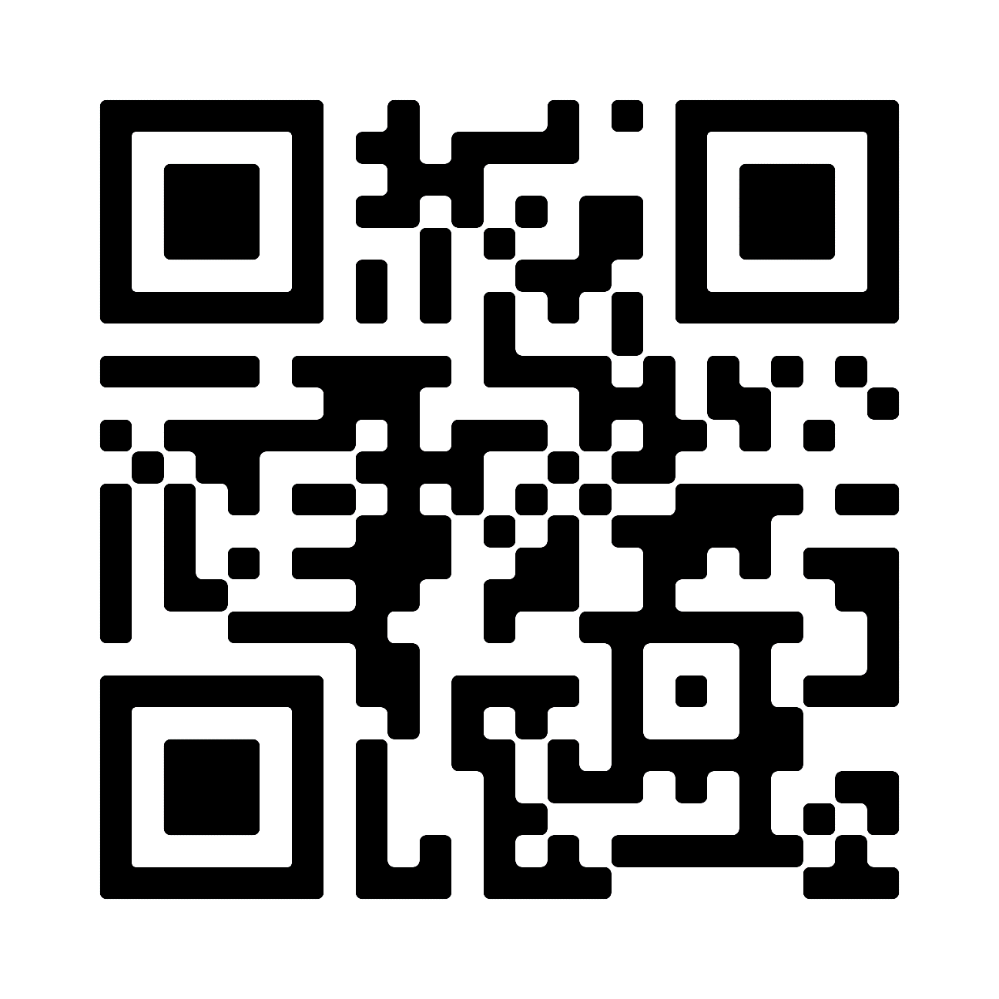


Header
Leader Training
Scout Fundraising
Videos
Leader Portal - Training page
Returning Leaders
What’s New?
New Leaders
Ideal Year of Scouting
Unit Kickoff & Parent Buy-In
Leader Portal training
Storefront Best Practices
Storefront Reservations & Management
Managing Inventory
Sale Resources
Leader Portal - Training page
Leader Guide
Unit Program Planner
Scout & Parent Guide
Banner
Table Payments Sign
Scout Pitch
Q&A Webinars
Please watch the training videos before
Trail’s End experts will stay on and answer every question!

Slide 12
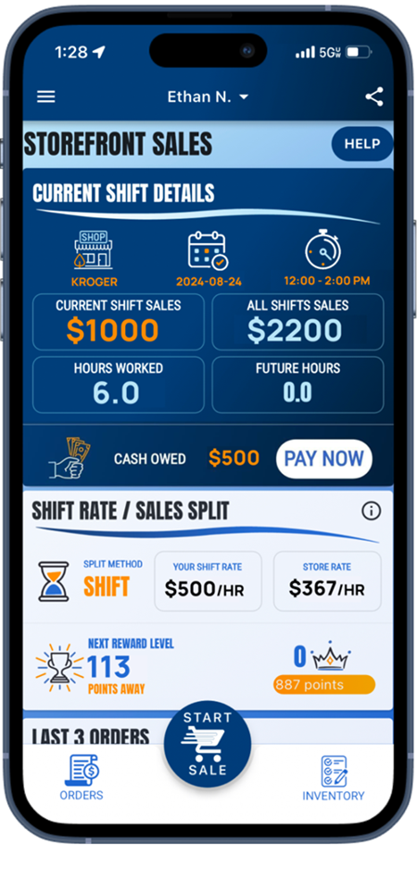
Header
Trail’s End App
Scout Fundraising
Save Time Managing Your Sale!
Scouts use the App to…
track and report real-time storefront, wagon and online sales
accept cash and credit cards
track inventory by Scout and storefront
schedule Scouts for storefronts.
Free Credit Card Processing
Powered by Square | Paid by Trail’s End
Available in Apple and Google Play Stores
New Scouts
Use Unit’s Trail’s End Code or their zip code to register.
Families can use one email for multiple accounts.
Returning Scouts
Sign in using 2023 username
Families: click name dropdown at top of screen to switch between accounts in the App

Slide 13
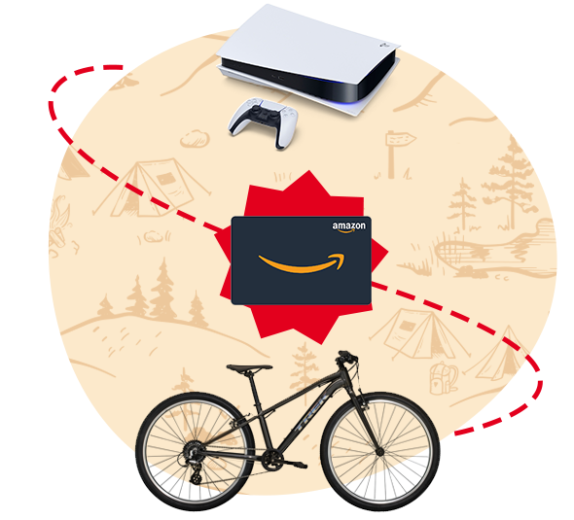
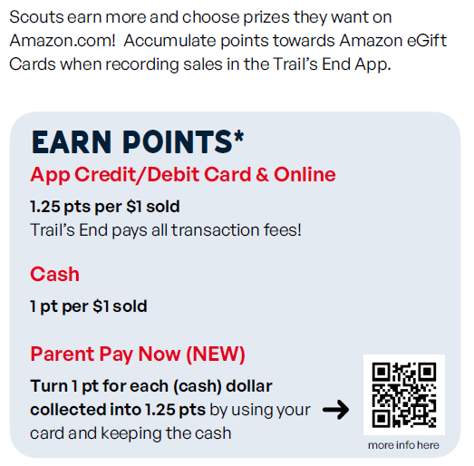
Scouts accumulate points towards Amazon eGift Cards when recording sales in the Trail’s End App.
Bonuses
Sell $500/hour per Scout for any 2-hour storefront shift or longer (July 1 – Dec 15) and earn 0.5 bonus points per $1 sold. To qualify, Unit must select – One Scout per shift split method.
Sell $250+ online (July 1 – Aug 31) and earn 100 bonus points.
Scout
Rewards
Scout Fundraising
Notes:
Make point values BIGGER; Parent Pay Now

Slide 14
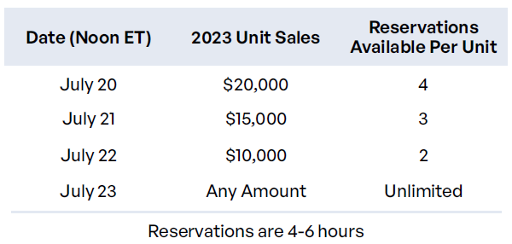
Header
Storefront Settings & Reservations
Scout Fundraising
The BEST, Most Fair & Highest Selling split is One Scout and their Parent
Reservations
Trail’s End is reserving the best-selling times and storefronts for your Scout families!
Reserve on Storefront Reservations page
Best hours will be highlighted
Default Settings
Before reserving, set your split method.
One Scout and their Parent is the BEST split!
    Scouts credited for each sale recorded.
    Safest and Scout sales won’t go down like other splits.
    Scouts sell $244 more than other splits.
    Units raise $50 more per hour per Scout.
Best practice: 2 hour shifts.
Notes:
One Scout and their Parents

Slide 15

sell
sell
sold; selling
transitive verb
to give up (property) to another for something of value (such as money)

Slide 16



Ways to Sell
Scout Fundraising
Storefronts
Setup tables at high foot traffic locations.
Scouts sell to customers coming in and out of stores.
Best Practice: One Scout and their parent per shift.
Wagon
Sell door-to-door
Best Practice: Bring product with you to avoid second trip to deliver.
Scouts can record undelivered orders in App.
Online
Sell virtually to family and friends by sharing your online fundraising page via social, email & text.
Product ships to the customer.
Safest way to sell!

Slide 17
Header
Storefront Best Practices
Scout Fundraising
One Scout and their Parent - Making $500/hour a Reality!
Prep
Enough popcorn to sell $500 per hour.
A fully charged phone with the Trail’s End App.
Bluetooth Square reader
6-foot table & banner
Cash box with small bills.
Scout should use the restroom before shift.
Place products highest to lowest.
NEVER put prices on table.
Scout Role
Wear your uniform.
Stand in front of the table.
Smile & walk up to everyone.
Look the customer in the eye and give your pitch.
Guide them to the table to pick their products.
It helps to memorize the prices!
Let your parent handle the money so you can get more customers.
Parent Role
Encourage your Scout to keep asking. No’s happen, that’s okay!
Handle table and products setup.
Stand and thank everyone!
Share what your Scout will get with the consumers’ support.
Enter orders so your Scout can get more customers.
Submit all donations in App.
Notes:
Parent Pay Now & Heroes & Helpers

Slide 18
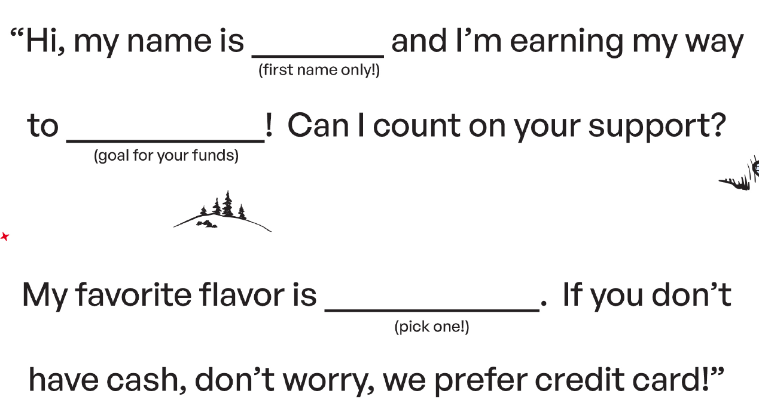
Header
Scout Pitch
Scout Fundraising
NEVER, NEVER, NEVER ask customers to buy popcorn. It’s to support You!
Even if the customer says no, always say, “Thank you” and “Have a good day.”
Notes:
Parent Pay Now & Heroes & Helpers

Slide 19






Header
Credit Card
Scout Fundraising
Credit is Best for Scouts
Safer, easier & higher sales for Scouts!
Trail’s End pays all fees!
Ways to accept credit in App:
      Square Bluetooth - contactless cards, chip cards, Apple Pay & Google Pay
      Square Swipers: Lighting (Apple) & Headphone jack (Android)
      Manual Entry (no reader): type card
      Apple Pay, Google Pay & Cash App Pay: use share feature at checkout for customers to pay on their device!
^{NEW}
Cash to Credit
Parents
Use their card and keep the cash.
Available at end of shift (up to 30 minutes after).
Scouts earn more Rewards.
Leaders
Use their card and keep the cash.
Available after shift until 2:59am ET.
Scouts earn more Rewards.

Slide 20







Products
Scout Fundraising
^{$15$$15}
$25
$25
$25
$20
$15
$15
^{NEW}
Heroes & Helpers Donations
Donations in App will be automatically processed nightly & reflected on Unit orders, eliminating manual ordering, and saving time!
Products and flavors consumers purchase every day.
Fewer products simplifies the sale for Councils, Units & Scouts.

Slide 21


Header
Online Best Practices
Scout Fundraising
Safe & Easy
Trail’s End ships the product directly to the customer.
No handling of products or cash for Scouts or Unit.
As many traditional products and prices as possible.
Additional products online.
Customize Page
Upload a profile picture.
Write a description - “Tell your customers why they should support Scout fundraising.”
Select your favorite product.
Share
Share your online fundraising page link with family and friends!
Use the App to post on social, send emails and texts & generate a QR code.
Follow-up with customers who have not bought.
Notes:
Parent Pay Now & Heroes & Helpers

Slide 22

wrap up
wrap·up
wrapped up; wrapping up; wraps up
transitive verb
to bring to a usually successful conclusion

Slide 23





Steps
Scout Fundraising
Place Final Order
Collect undelivered orders from Scouts.
Go to “Popcorn Orders” page in Leader Portal.
The system will highlight shortages using App sales and previous Unit orders.
Request Unit Payout
Go to Account Summary page in Leader Portal.
Ensure Unit Invoice is paid.
How to request payout:
Enter the Unit’s bank account on Unit Info page.
Click Request Payout.
Submit Rewards
Submit Unit’s Rewards order when ready.
Amazon eGift Cards will release 5 days later for Scouts to claim in App.
Submit again for Scouts that sell more and earn a bigger eGift Card.

Slide 24
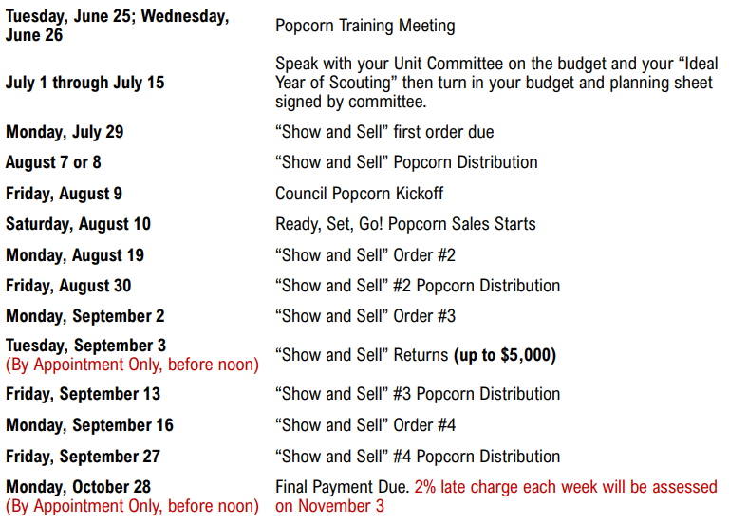
Header
Council Sale Details - Dates
Scout Fundraising

Slide 25
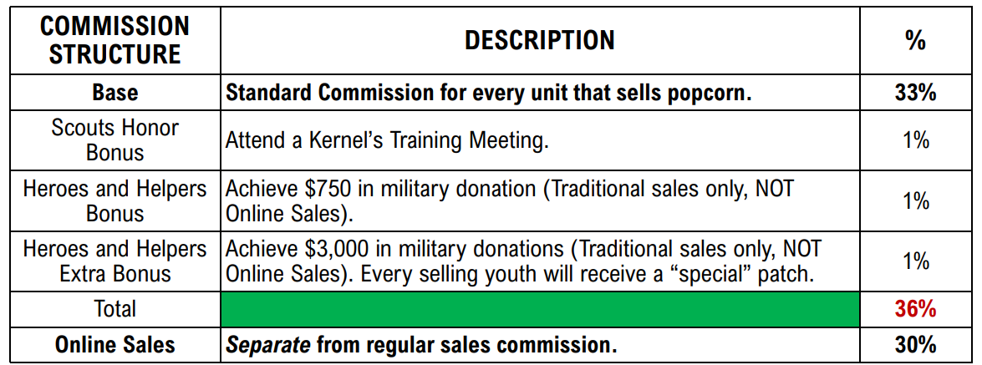
Header
Council Sale Details - Commission
Scout Fundraising

Slide 26
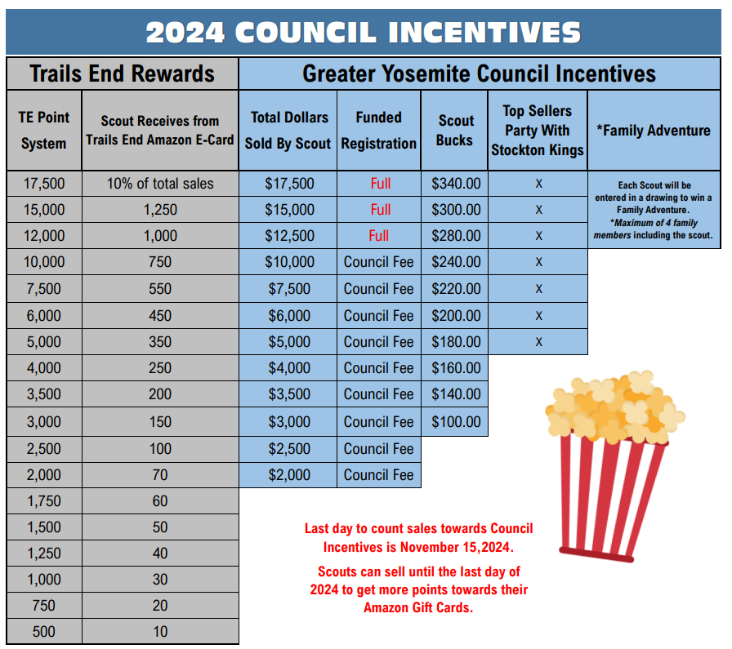
Header
Council Sale Details - Incentives
Scout Fundraising
Notes:
Parent Pay Now & Heroes & Helpers

Slide 27
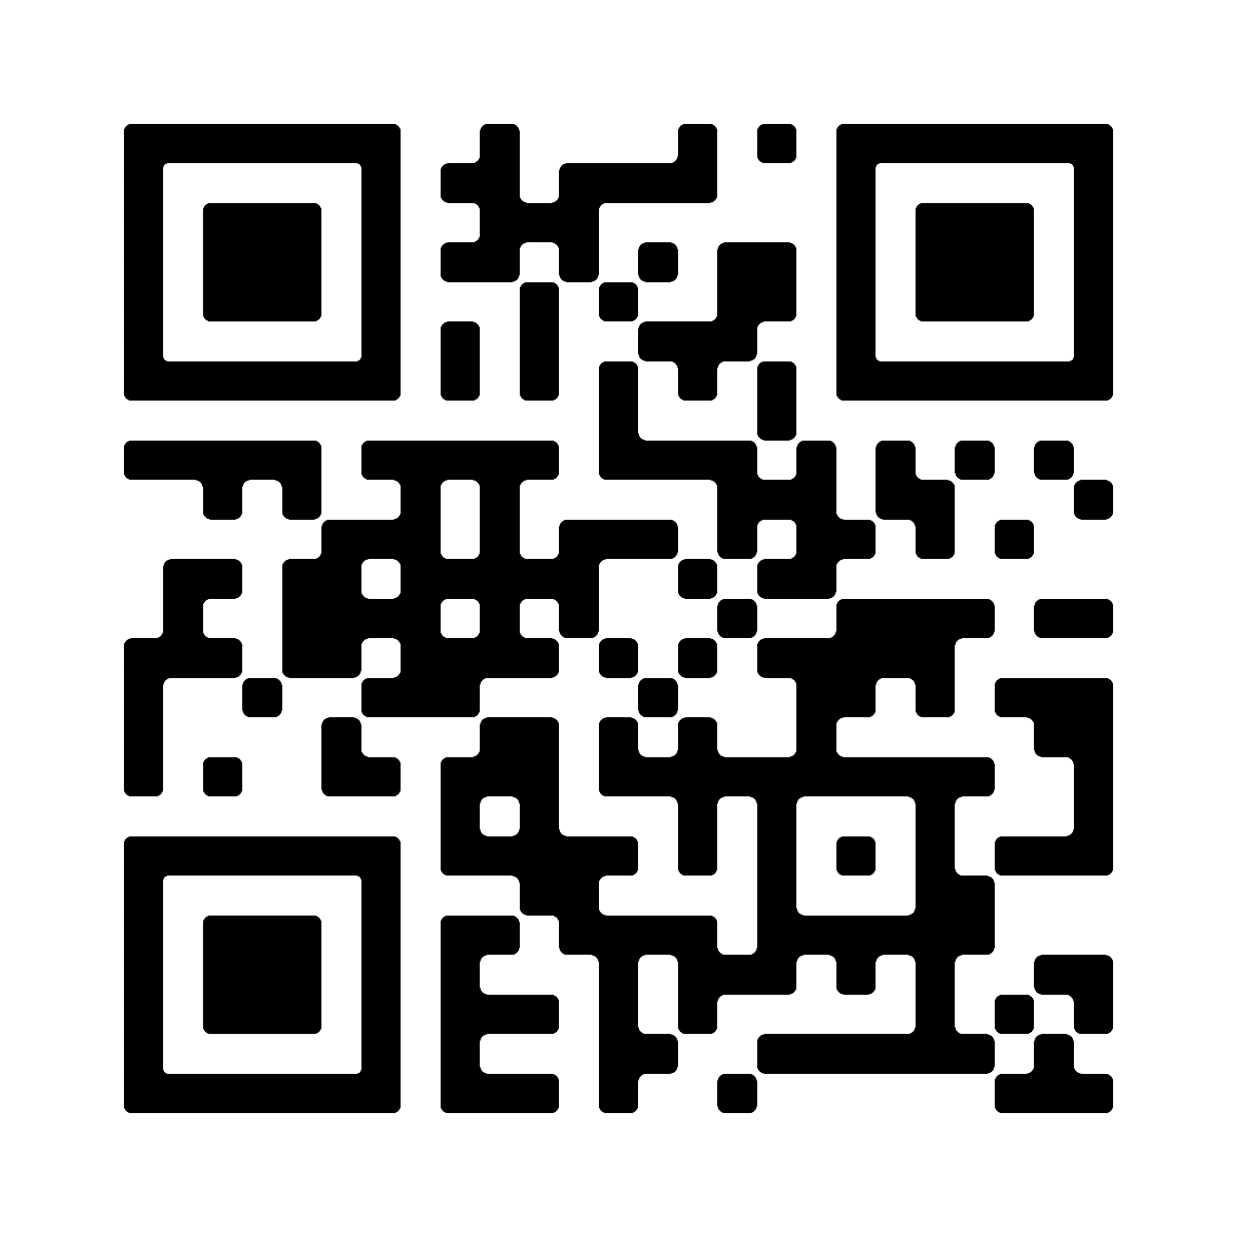

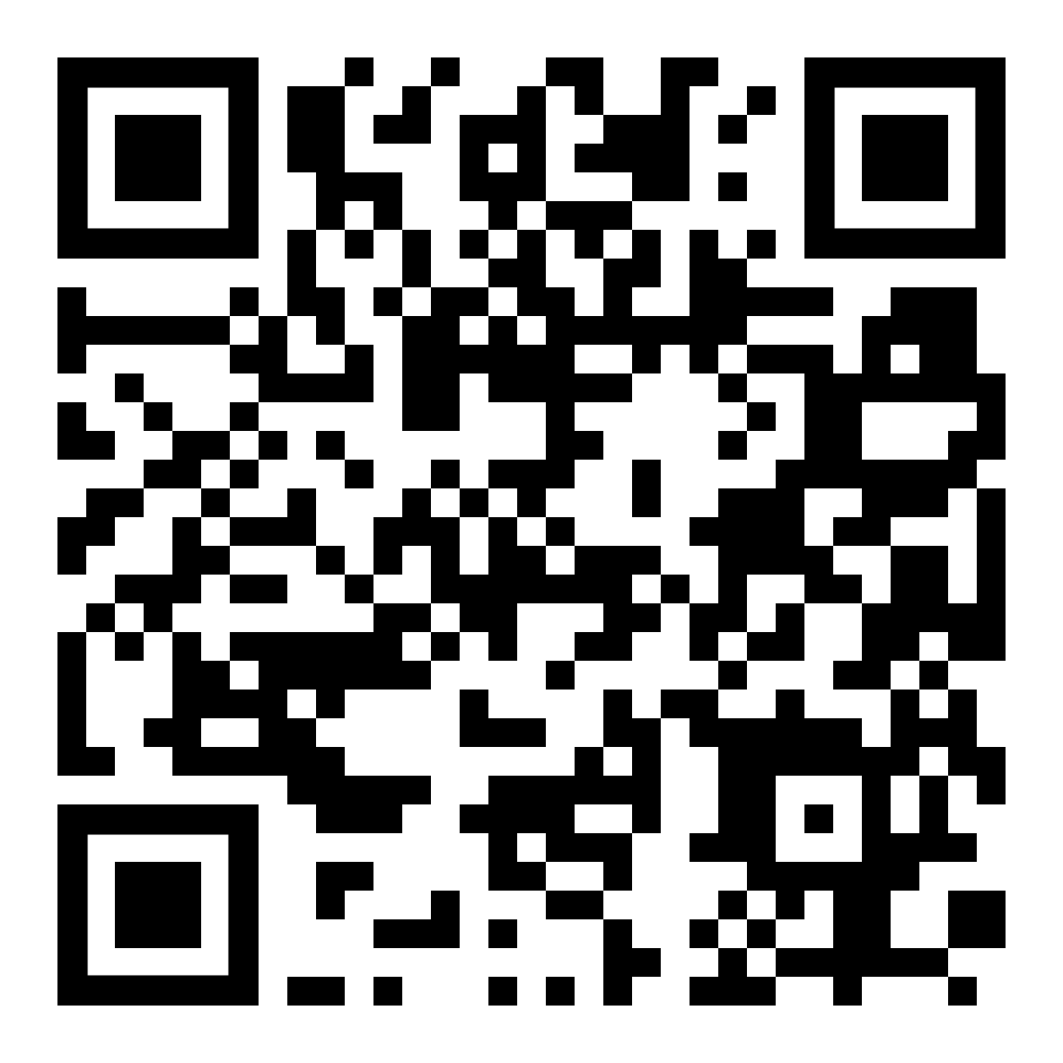
Support
Scout Fundraising
Trail’s End Support
Visit our FAQ page for answers to commonly asked questions & to open a ticket.
Council Support
Kelly Osterhout - Volunteer
kelly@bluesierrafarms.com
209-614-6194
Marisol Gonzalez – Staff Advisor
marisol.gonzalezcuevas@scouting.org
209-637-3949
Council Facebook Group:
Facebook Group
Join Trail’s End Popcorn Community for best practices, support, news, and answers to questions.

Slide 28
Scout Fundraising
Thank You!
Blank Background

